Slide 1
The diversity of Mexico
How are the Mexican states integrated?
What are the differences between each state ?
What is the origin of the Mexican people ?
How can we summarized the Mexican national characteristics ?
Lets talk about How Mexico is different from each zone.
Profr. José Luis Gómez Gutiérrez
June 24, 2002
FLORIDA SUMMER MIGRANT LEADERSHIP INSTITUTE
FLORIDA GOLF COAST UNIVERSITY
Mexican Exchange Teacher 2002 in Florida

Slide 2
In this part we are going to look inside the indigenes towns from Mexico.
We can talk from Oaxaca, One important state with multicultural and multilingual customs and traditions.
Mexico has 62 indigenous towns.
An Hispanic influence in the colonial age.
Also, Arabian culture influenced Spain.
French and American wars.
Modern world.
Technologies and communication times.

Slide 3

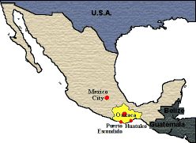
Oaxaca
It has peaks almost 10,000 feet (more than 3,000 meters) high, caverns among the deepest in the world, virgin beaches, hidden jungles, and luminous valleys that house populations where, as a crucible, cultures of all people who once lived in its midst come together
Oaxaca, the State Capital, declared Humanity’s Cultural Patrimony by UNESCO, owes its fame to the beauty and harmony of its architecture, the richness of its cultural traditions, the wide variety of its typical foods, and its soft temperate climate, spring-like throughout the year.

Slide 4
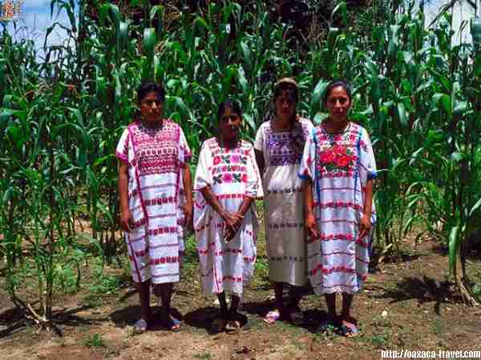
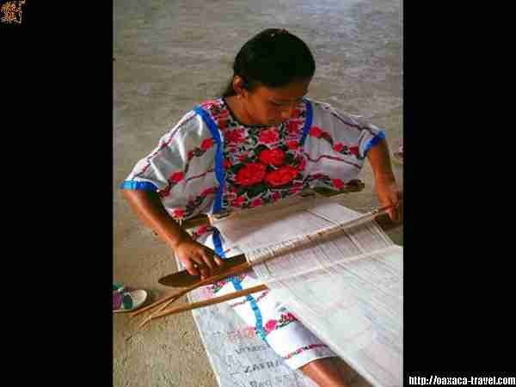
Amuzgos
Nothing is known about ancient dwellers of the region currently occupied by the Amuzgos. The first information about this group dates from the first years of the Spanish conquest. They resided in part of the province of Ayacastla and had Igualapa as their capital city. Their territory extended from the banks of the Ayutla River to the west, the Manialtepec to the north, and reached the sea in the south. The Amuzgos inhabited the towns of Xiyacan, Ayotzinapa and Xochistlahuaca, and lived mutually with the Ayacastecas, in Ometepec and Igualapa

Slide 5
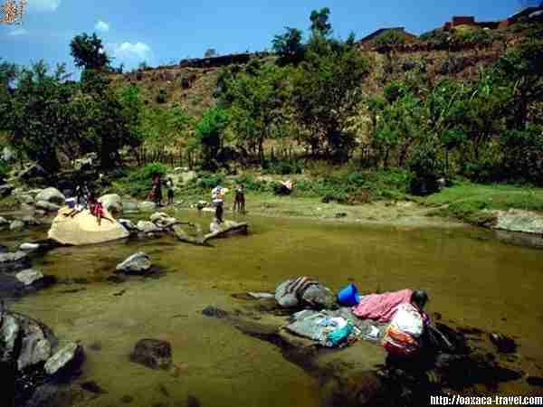
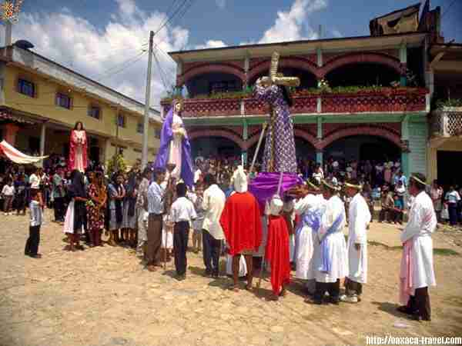
Chatinos
There is very little information on the history of the Chatino nation. Researchers believe they were one of the first groups to inhabit the State of Oaxaca. In his book, “Historia de Oaxaca” [Oaxaca's History], José Antonio Gay speculates that “they probably reached shore in the Chacahua Lagoon, on the banks of Grande River, or some nearby shore, coming from a distant land". At that time, the area was scarcely populated, as the Zapotecs and Mixtecos had not yet settled, which allowed Chatinos to establish themselves in an intermediate area between these two groups. Currently, this zone belongs to the Municipality of Juquila, extending later to Teojomulco and Teozacualco, which were not sought after, as they were part of mountainous terrain.

Slide 6
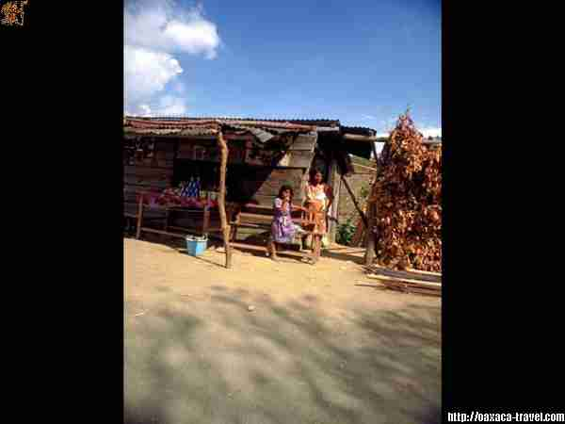
In ancient times, the Chatinos were considered a military race, having made war on the Zapotecs and Mixtecos, being vanquished by the latter before the arrival of the Spanish.

Slide 7
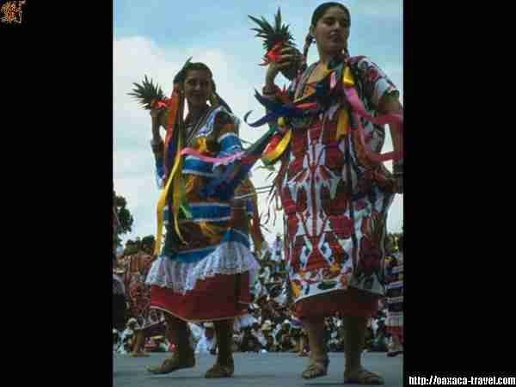
Chinantecos
Historical Background
The Chinantla region, in north-west Oaxaca, has been populated, approximately, since the Upper Pre-classic period. The origin of its settlers is unknown; archaeological remains indicate the presence of some groups who lived in caves, where stone slabs have been discovered, as well as doors and doorposts of small flagstone, stucco, and mud dwellings near rivers.
Piña dulce dance

Slide 8
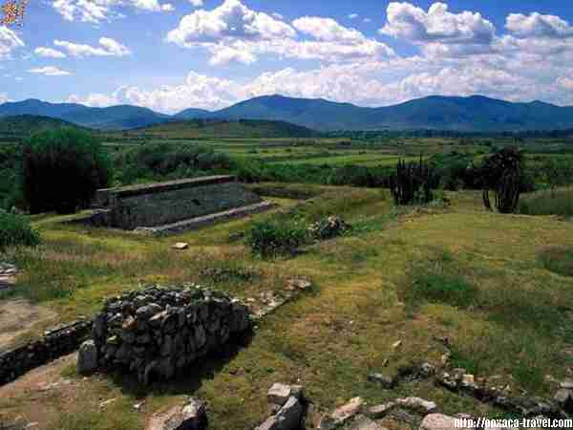
PYRAMIDS AND ARCHEOLIGICAL PLACES
DAINZU

Slide 9
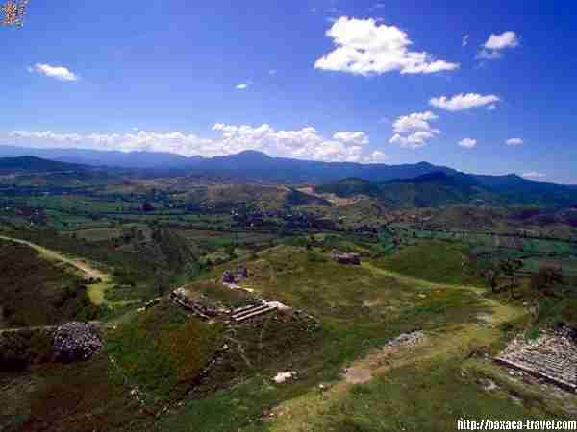
PYRAMIDS AND ARCHEOLIGICAL PLACES
HUIJAZOO

Slide 10
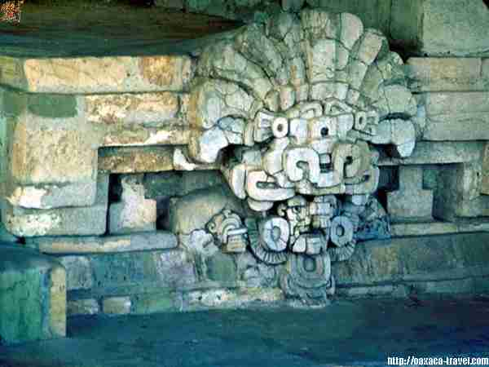
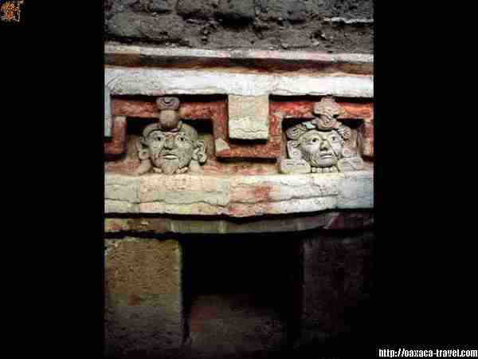
PYRAMIDS AND ARCHEOLIGICAL PLACES
HUIJAZOO
COCIJO’S GOD
TOMB

Slide 11
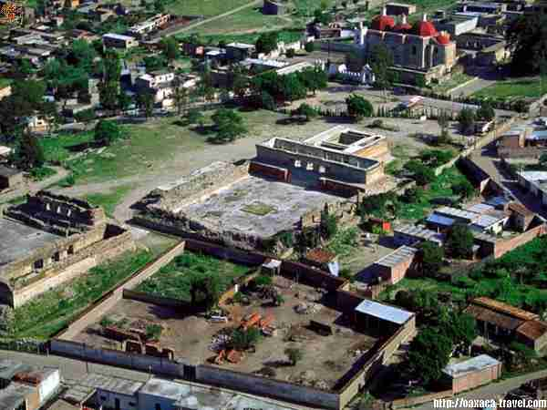
PYRAMIDS AND ARCHEOLIGICAL PLACES
MITLA

Slide 12
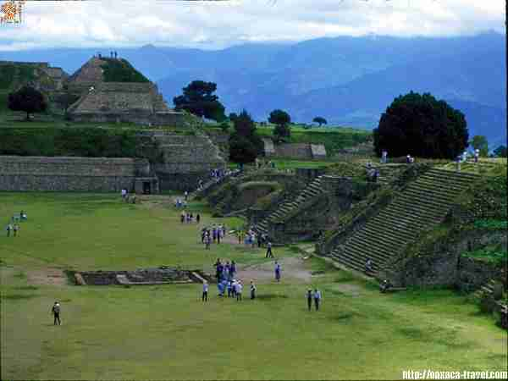
PYRAMIDS AND ARCHEOLIGICAL PLACES
MONTEALBAN

Slide 13
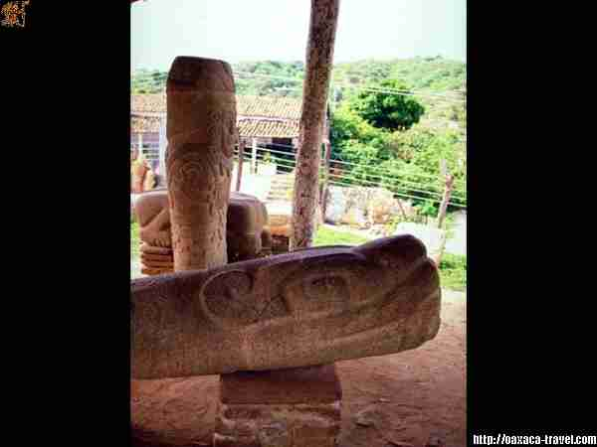
ARCHEOLIGICAL PIECES
TUTUTEPEC

Slide 14
Another indigenes groups in Oaxaca
Amuzgos
Chatinos
Chinantecos
Chochos
Chontales
Cuicatecos
Huaves
Ixcatecos
Zoques
Mazatecos
Mixes
Mixtecs
Popolocas
Tacuates
Triquis
Zapotecs

Slide 15
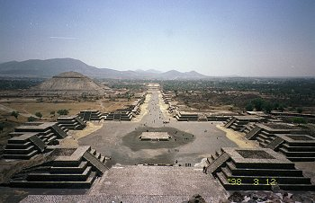
Mexico City
Plaza of the Moon and Avenue of the Dead. View from the Pyramid of the Moon.
The size of the Pyramid of the Moon is 140mx150m at the base, 45.8m height. A.D.100-350.
Pyramid of the Sun is middle of left side.

Slide 16
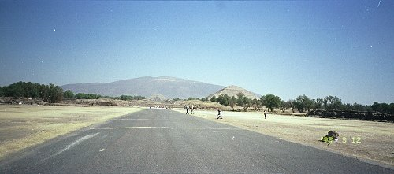
View from the end of the Avenue of the Dead.

Slide 17
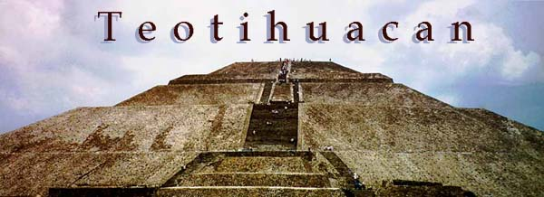
Sun Pyramid

Slide 18
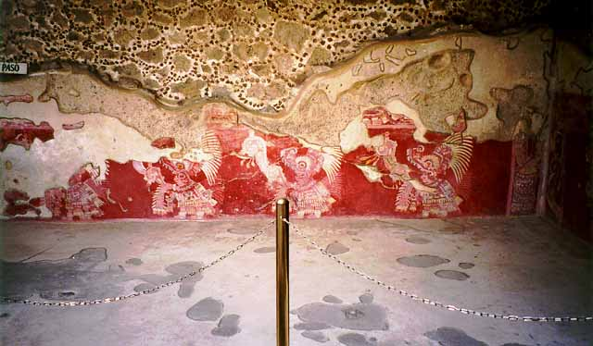
Tepantitla Prehispanic Paints

Slide 19
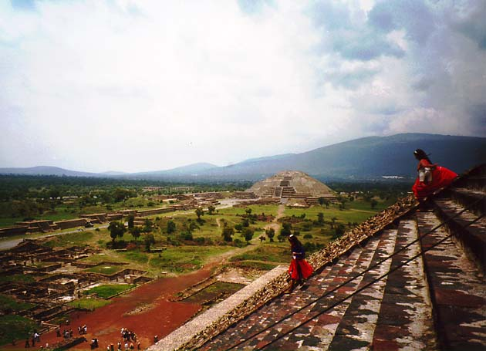
Sightseeing from Moon Pyramid

Slide 20
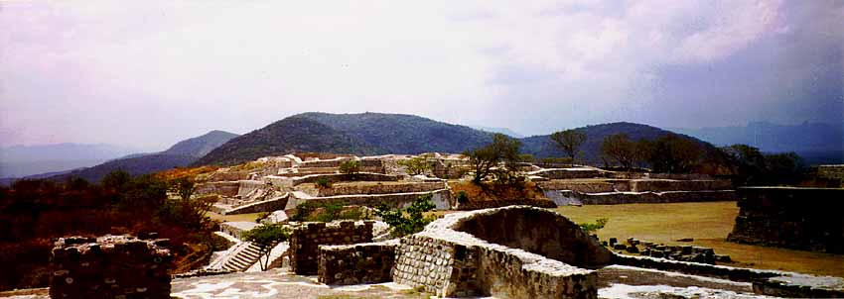
Xochicalco, Morelos. National Park
Elite residences

Slide 21
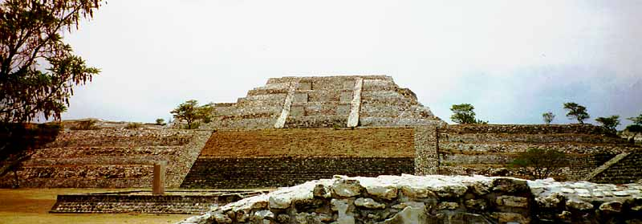
The Grand Pyramid, with the "stela of two glyphs"

Slide 22
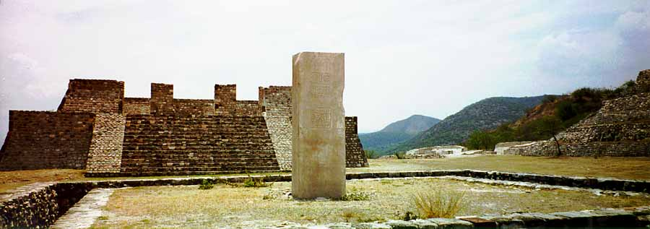
The "stela of two glyphs"
View facing away from the Grand Pyramid

Slide 23
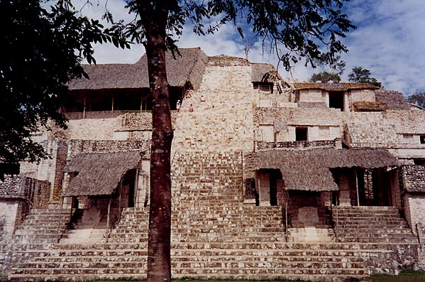
MAYAN CULTURE
The central staircase of La Torre.
Newly discovered stucco work lies beneath each thatched roof.

Slide 24
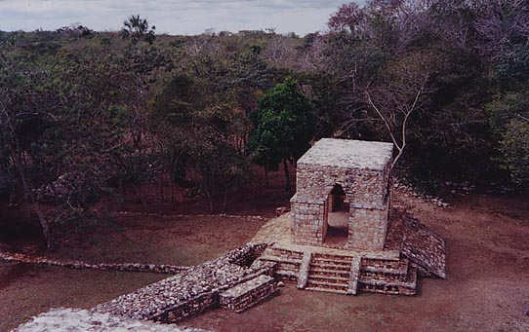
You enter the site along one of the sites sacbeob, or raised causeways (center-left).
This leads to a newly reconstructed freestanding arch (center).
This entry was once closed off by sealing the arch entryway
and the creation of defensive walls around the perimeter of the sie core (lower-left).

Slide 25
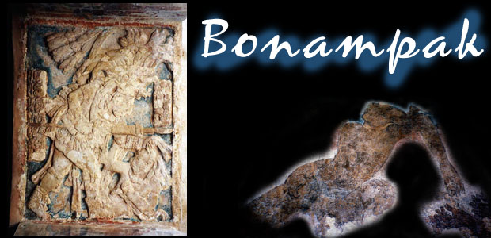

Slide 26
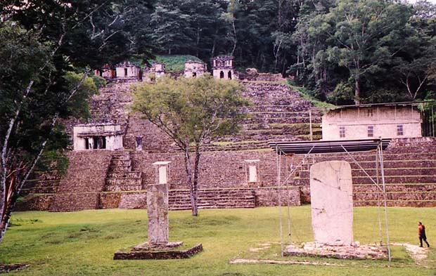
Bonampak Acropolis

Slide 27
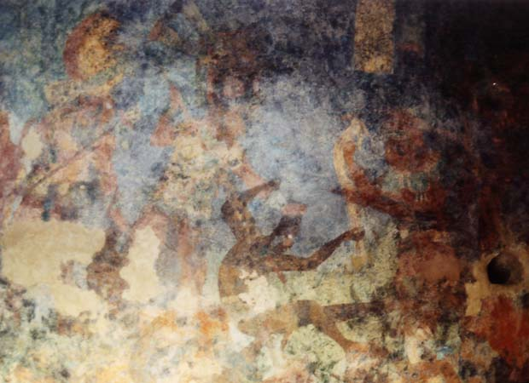
Bonampak Room 2

Slide 28
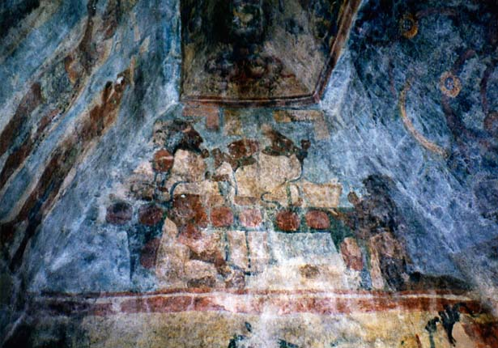
Bonampak Structure 1, Room 3

Slide 29
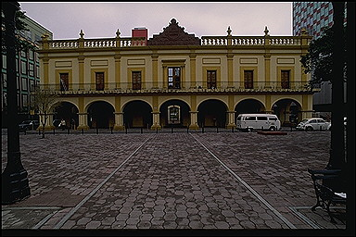
Monterrey, Mexico. Tourism Building
Spanish Colonial Building

Slide 30
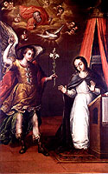
MUSEO NACIONAL DE LAS INTERVENCIONES
Sala de Intervención Española de 1829.
Sala de Intervención Francesa de 1838 - 1839
Sala de Intervención Norteamericana de 1846 - 1848
Sala de Intervención Francesa de 1862 - 1867
Sala Intervención Norteamericana de 1914.
Sala Intervención Norteamericana 1916

Slide 31
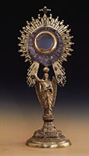
Museo Nacional del Virreinato
En este museo se exhibe una importante y completa colección de arte religioso de la época del Virreinato.

Slide 32
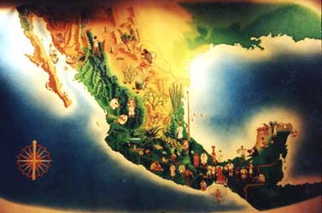

Slide 33
All states in Mexico have native prehispanic roots. Some have more archeological zones and towns than others, even in the same country:
Chiapas
Estado de Mexico
Yucatan
Campeche
Quintana Roo
Michoacan
Morelos Hidalgo
Tlaxcala Yucatan
Oaxaca
Others states have strong influence from the Spaniard colonial System or from French invasion:
Jalisco
Guanajuato
Aguascalientes
Zacatecas
Puebla
San Luis Potosi
Queretaro
Some states have natural American influence, because they are border states:
Chihuahua
Cohahulia
Tamaulipas
Sonora
Baja California
Nuevo Leon

Slide 34
Some states have the coast development and its natural influence:
Guerrero
Nayarit
Colima
Tabasco
Sinaloa
Baja California Sur
And the city that joins this mix and exchange of values, music, roots, new generations:
Mexico City

Slide 35
Resume
We can talk about four Mexico's Zones:
North
Middle
South
And coasts
Also, we might find diversity in:
Big and modern cities
Small cities
Towns
Small villages where is difficult to arrive.

Slide 36
Resume 2
We can talk about four points of view that people share in Mexico:
North: Modern and Technological
Middle: Commercial and traditional
South: Natural environment
Coast: Tourist development
Also, we might find diversity in:
Food
Music
Folk
Languages: 40 native tongues and a great Spanish variety.

Slide 37
Resume
We have to study our past, so we can enjoy our roots and origin, also we have to try to learn and understand our present.
And the best. I have extra values if I am Binational.
Mexican
American

